Slide 1
CSE245- Divide & Conquer
Md. Shamsujjoha

Slide 2
Divide and Conquer Algorithms
Example
Binary Search
Merge Sort
Quick Sort
Counting Inversion
Closest Pair of Points

Slide 3
Divide and Conquer
Divide the problem into a number of subproblems
There must be base case (to stop recursion).
Conquer (solve) each subproblem recursively
Combine (merge) solutions to subproblems into a solution to the original problem

Slide 4
Divide-and-Conquer
Most common usage.
Break up problem of size n into two equal parts of size ½n.
Solve two parts recursively.
Combine two solutions into overall solution in linear time.
Consequence.
Brute force: n².
Divide-and-conquer: n log n.

Slide 5
Counting Inversions

Slide 6
Counting Inversions
Music site tries to match your song preferences with others.
You rank n songs.
Music site consults database to find people with similar tastes.
Similarity metric: number of inversions between two rankings.
My rank: 1, 2, …, n.
Your rank: a₁, a₂, …, a_{n}.
Songs i and j inverted if i <= j, but a_{i} > a_{j}.
Brute force: check all Θ(n²) pairs i and j.
Songs
A
B
C
D
E
Me
1
2
3
4
5
Inversions
3-2, 4-2
You
1
3
4
2
5
Notes:
amazon.com, launch.com, restaurants, movies, . . .
Note: there can be a quadratic number of inversions.
Asymptotically faster algorithm must compute total number without even looking at each inversion individually.

Slide 7
Counting Inversions: Divide-and-Conquer
Divide-and-conquer.
1
5
4
8
10
2
6
9
12
11
3
7

Slide 8
Counting Inversions: Divide-and-Conquer
Divide-and-conquer.
Divide: separate list into two pieces.
1
5
4
8
10
2
6
9
12
11
3
7
Divide: O(1).
1
5
4
8
10
2
6
9
12
11
3
7

Slide 9
Counting Inversions: Divide-and-Conquer
Divide-and-conquer.
Divide: separate list into two pieces.
Conquer: recursively count inversions in each half.
1
5
4
8
10
2
6
9
12
11
3
7
Divide: O(1).
1
5
4
8
10
2
6
9
12
11
3
7
Conquer: 2T(n / 2)
5 blue-blue inversions
8 green-green inversions
5-4, 5-2, 4-2, 8-2, 10-2
6-3, 9-3, 9-7, 12-3, 12-7, 12-11, 11-3, 11-7

Slide 10
Counting Inversions: Divide-and-Conquer
Divide-and-conquer.
Divide: separate list into two pieces.
Conquer: recursively count inversions in each half.
Combine: count inversions where a_{i} and a_{j} are in different halves, and return sum of three quantities.
1
5
4
8
10
2
6
9
12
11
3
7
Divide: O(1).
1
5
4
8
10
2
6
9
12
11
3
7
Conquer: 2T(n / 2)
5 blue-blue inversions
8 green-green inversions
9 blue-green inversions
5-3, 4-3, 8-6, 8-3, 8-7, 10-6, 10-9, 10-3, 10-7
Combine: ???
Total = 5 + 8 + 9 = 22.

Slide 11
Merge and Count
Merge and count step.
Given two sorted halves, count number of inversions where a_{i} and a_{j} are in different halves.
Combine two sorted halves into sorted whole.
smallest i = 6
smallest j = 6
3
7
10
14
18
19
2
11
16
17
23
25
N/2 = 6
auxiliary array
current
Inversions: Total: 0

Slide 12
Merge and Count
Merge and count step.
Given two sorted halves, count number of inversions where a_{i} and a_{j} are in different halves.
Combine two sorted halves into sorted whole.
smallest i = 6
smallest j = 5
3
7
10
14
18
19
2
11
16
17
23
25
N/2 = 6
2
auxiliary array
current
Inversions: 6 Total: 6

Slide 13
Merge and Count
Merge and count step.
Given two sorted halves, count number of inversions where a_{i} and a_{j} are in different halves.
Combine two sorted halves into sorted whole.
smallest i = 6
smallest j = 5
3
7
10
14
18
19
2
11
16
17
23
25
N/2 = 6
2
auxiliary array
current
Inversions: 6 Total: 6

Slide 14
Merge and Count
Merge and count step.
Given two sorted halves, count number of inversions where a_{i} and a_{j} are in different halves.
Combine two sorted halves into sorted whole.
smallest i = 5
smallest j = 5
3
7
10
14
18
19
2
11
16
17
23
25
N/2 = 6
2
3
auxiliary array
current
Inversions: 6 Total: 6

Slide 15
Merge and Count
Merge and count step.
Given two sorted halves, count number of inversions where a_{i} and a_{j} are in different halves.
Combine two sorted halves into sorted whole.
smallest i = 5
smallest j = 5
3
7
10
14
18
19
2
11
16
17
23
25
N/2 = 6
2
3
auxiliary array
current
Inversions: 6 Total: 6

Slide 16
Merge and Count
Merge and count step.
Given two sorted halves, count number of inversions where a_{i} and a_{j} are in different halves.
Combine two sorted halves into sorted whole.
smallest i = 4
smallest j = 5
3
7
10
14
18
19
2
11
16
17
23
25
N/2 = 6
2
3
7
auxiliary array
current
Inversions: 6 Total: 6

Slide 17
Merge and Count
Merge and count step.
Given two sorted halves, count number of inversions where a_{i} and a_{j} are in different halves.
Combine two sorted halves into sorted whole.
smallest i = 4
smallest j = 5
3
7
10
14
18
19
2
11
16
17
23
25
N/2 = 6
2
3
7
auxiliary array
current
Inversions: 6 Total: 6

Slide 18
Merge and Count
Merge and count step.
Given two sorted halves, count number of inversions where a_{i} and a_{j} are in different halves.
Combine two sorted halves into sorted whole.
smallest i = 3
smallest j = 5
3
7
10
14
18
19
2
11
16
17
23
25
N/2 = 6
2
3
7
10
auxiliary array
current
Inversions: 6 Total: 6

Slide 19
Merge and Count
Merge and count step.
Given two sorted halves, count number of inversions where a_{i} and a_{j} are in different halves.
Combine two sorted halves into sorted whole.
smallest i = 3
smallest j = 5
3
7
10
14
18
19
2
11
16
17
23
25
N/2 = 6
2
3
7
10
auxiliary array
current
Inversions: 6 Total: 6

Slide 20
Merge and Count
Merge and count step.
Given two sorted halves, count number of inversions where a_{i} and a_{j} are in different halves.
Combine two sorted halves into sorted whole.
smallest i = 3
smallest j = 4
3
7
10
14
18
19
2
11
16
17
23
25
N/2 = 6
2
3
7
10
11
auxiliary array
Inversions: 6 + 3 Total: 9

Slide 21
Merge and Count
Merge and count step.
Given two sorted halves, count number of inversions where a_{i} and a_{j} are in different halves.
Combine two sorted halves into sorted whole.
smallest i = 3
smallest j = 4
3
7
10
14
18
19
2
11
16
17
23
25
N/2 = 6
2
3
7
10
11
auxiliary array
Inversions: 6 + 3 Total: 9

Slide 22
Merge and Count
Merge and count step.
Given two sorted halves, count number of inversions where a_{i} and a_{j} are in different halves.
Combine two sorted halves into sorted whole.
smallest i = 2
smallest j = 4
3
7
10
14
18
19
2
11
16
17
23
25
N/2 = 6
2
3
7
10
11
14
auxiliary array
Inversions: 6 + 3 Total: 9

Slide 23
Merge and Count
Merge and count step.
Given two sorted halves, count number of inversions where a_{i} and a_{j} are in different halves.
Combine two sorted halves into sorted whole.
smallest i = 2
smallest j = 4
3
7
10
14
18
19
2
11
16
17
23
25
N/2 = 6
2
3
7
10
11
14
auxiliary array
Inversions: 6 + 3 Total: 9

Slide 24
Merge and Count
Merge and count step.
Given two sorted halves, count number of inversions where a_{i} and a_{j} are in different halves.
Combine two sorted halves into sorted whole.
smallest i = 2
smallest j = 3
3
7
10
14
18
19
2
11
16
17
23
25
N/2 = 6
2
3
7
10
11
14
16
auxiliary array
Inversions: 6 + 3 + 2 Total: 11

Slide 25
Merge and Count
Merge and count step.
Given two sorted halves, count number of inversions where a_{i} and a_{j} are in different halves.
Combine two sorted halves into sorted whole.
smallest i = 2
smallest j = 3
3
7
10
14
18
19
2
11
16
17
23
25
N/2 = 6
2
3
7
10
11
14
16
auxiliary array
Inversions: 6 + 3 + 2 Total: 11

Slide 26
Merge and Count
Merge and count step.
Given two sorted halves, count number of inversions where a_{i} and a_{j} are in different halves.
Combine two sorted halves into sorted whole.
smallest i = 2
smallest j = 2
3
7
10
14
18
19
2
11
16
17
23
25
N/2 = 6
2
3
7
10
11
14
16
17
auxiliary array
Inversions: 6 + 3 + 2 + 2 Total: 13

Slide 27
Merge and Count
Merge and count step.
Given two sorted halves, count number of inversions where a_{i} and a_{j} are in different halves.
Combine two sorted halves into sorted whole.
smallest i = 2
smallest j = 2
3
7
10
14
18
19
2
11
16
17
23
25
N/2 = 6
2
3
7
10
11
14
16
17
auxiliary array
Inversions: 6 + 3 + 2 + 2 Total: 13

Slide 28
Merge and Count
Merge and count step.
Given two sorted halves, count number of inversions where a_{i} and a_{j} are in different halves.
Combine two sorted halves into sorted whole.
smallest i = 1
smallest j = 2
3
7
10
14
18
19
2
11
16
17
23
25
N/2 = 6
2
3
7
10
11
14
16
17
18
auxiliary array
Inversions: 6 + 3 + 2 + 2 Total: 13

Slide 29
Merge and Count
Merge and count step.
Given two sorted halves, count number of inversions where a_{i} and a_{j} are in different halves.
Combine two sorted halves into sorted whole.
smallest i = 1
smallest j = 2
3
7
10
14
18
19
2
11
16
17
23
25
N/2 = 6
2
3
7
10
11
14
16
17
18
auxiliary array
Inversions: 6 + 3 + 2 + 2 Total: 13

Slide 30
Merge and Count
Merge and count step.
Given two sorted halves, count number of inversions where a_{i} and a_{j} are in different halves.
Combine two sorted halves into sorted whole.
smallest i = 0
smallest j = 2
first half exhausted
3
7
10
14
18
19
2
11
16
17
23
25
N/2 = 6
2
3
7
10
11
14
16
17
18
19
auxiliary array
Inversions: 6 + 3 + 2 + 2 Total: 13

Slide 31
Merge and Count
Merge and count step.
Given two sorted halves, count number of inversions where a_{i} and a_{j} are in different halves.
Combine two sorted halves into sorted whole.
smallest i = 0
smallest j = 2
first half exhausted
3
7
10
14
18
19
2
11
16
17
23
25
N/2 = 6
2
3
7
10
11
14
16
17
18
19
auxiliary array
Inversions: 6 + 3 + 2 + 2 Total: 13

Slide 32
Merge and Count
Merge and count step.
Given two sorted halves, count number of inversions where a_{i} and a_{j} are in different halves.
Combine two sorted halves into sorted whole.
smallest i = 0
smallest j = 2
first half exhausted
3
7
10
14
18
19
2
11
16
17
23
25
N/2 = 6
2
3
7
10
11
14
16
17
18
19
23
auxiliary array
Inversions: 6 + 3 + 2 + 2 + 0 Total: 13

Slide 33
Merge and Count
Merge and count step.
Given two sorted halves, count number of inversions where a_{i} and a_{j} are in different halves.
Combine two sorted halves into sorted whole.
smallest i = 0
smallest j = 1
first half exhausted
3
7
10
14
18
19
2
11
16
17
23
25
N/2 = 6
2
3
7
10
11
14
16
17
18
19
23
auxiliary array
Inversions: 6 + 3 + 2 + 2 + 0 Total: 13

Slide 34
Merge and Count
Merge and count step.
Given two sorted halves, count number of inversions where a_{i} and a_{j} are in different halves.
Combine two sorted halves into sorted whole.
smallest i = 0
smallest j = 0
first half exhausted
second half exhausted
3
7
10
14
18
19
2
11
16
17
23
25
N/2 = 6
2
3
7
10
11
14
16
17
18
19
23
25
auxiliary array
Inversions: 6 + 3 + 2 + 2 + 0 + 0 Total: 13

Slide 35
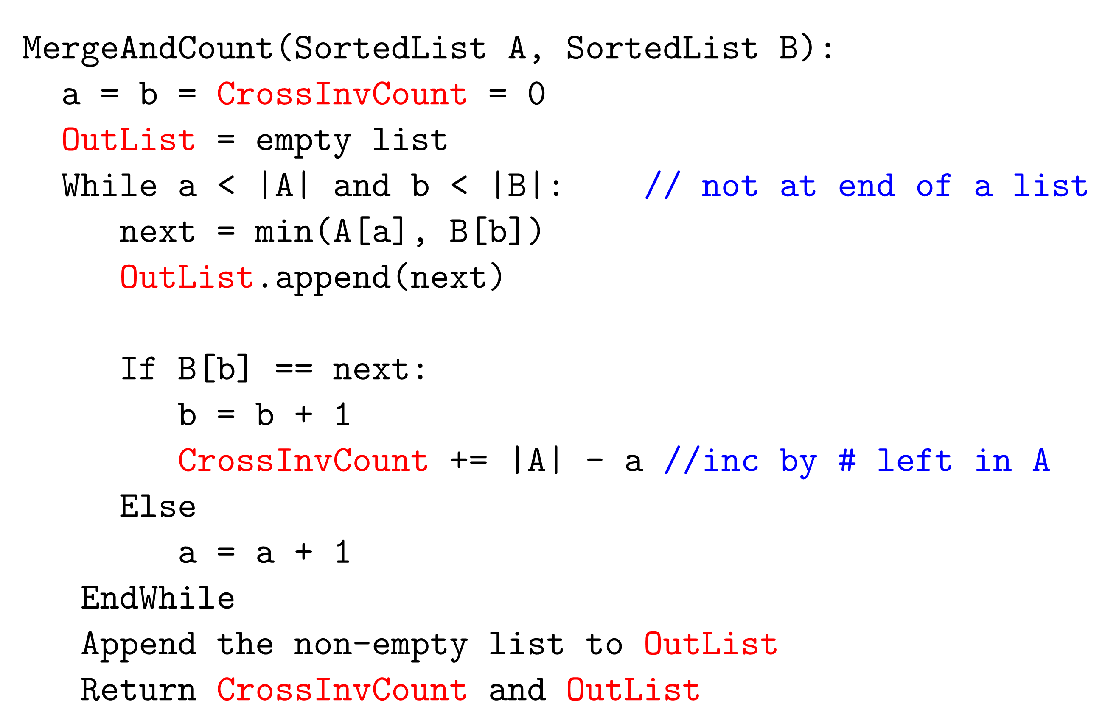
Merge and Count

Slide 36
Closest Pair of Points (from “Algorithm Design” by J.Kleinberg and E.Tardos)
Closest pair. Given n points in the plane, find a pair with smallest Euclidean distance between them (closest pair).
Fundamental geometric primitive.
Graphics, computer vision, geographic information systems, molecular modeling, air traffic control.
Special case of nearest neighbor, Euclidean MST, Voronoi.
Brute force. Check all pairs of points p and q with Θ(n²) comparisons.
1-D version. O(n log n) easy if points are on a line.
Assumption. No two points have same x coordinate.
Notes:
Foundation of then-fledgling field of computational geometry.
"Shamos and Hoey (1970's) wanted to work out basic computational primitives in computational geometry. Surprisingly challenging to find an efficient algorithm. Shamos and Hoey asked whether it was possible to do better than quadratic. The algorithm we present is essentially their solution."

Slide 37
Closest Pair of Points: First Attempt
Divide. Sub-divide region into 4 quadrants.
L

Slide 38
Closest Pair of Points: First Attempt
Divide. Sub-divide region into 4 quadrants.
Obstacle. Impossible to ensure n/4 points in each piece.
L

Slide 39
Closest Pair of Points
Algorithm.
Divide: draw vertical line L so that roughly ½n points on each side.
L

Slide 40
Closest Pair of Points
Algorithm.
Divide: draw vertical line L so that roughly ½n points on each side.
Conquer: find closest pair in each side recursively.
L
21
12

Slide 41
Closest Pair of Points
Algorithm.
Divide: draw vertical line L so that roughly ½n points on each side.
Conquer: find closest pair in each side recursively.
Combine: find closest pair with one point in each side.
Return best of 3 solutions.
seems like Θ(n²)
L
8
21
12

Slide 42
Closest Pair of Points
Find closest pair with one point in each side, assuming that distance < δ.
L
21
δ = min(12, 21)
12

Slide 43
Closest Pair of Points
Find closest pair with one point in each side, assuming that distance < δ.
Observation: only need to consider points within δ of line L.
L
21
δ = min(12, 21)
12
δ

Slide 44
Closest Pair of Points
Find closest pair with one point in each side, assuming that distance < δ.
Observation: only need to consider points within δ of line L.
Sort points in 2δ-strip by their y coordinate.
L
7
6
5
21
4
δ = min(12, 21)
12
3
2
1
δ

Slide 45
Closest Pair of Points
Find closest pair with one point in each side, assuming that distance < δ.
Observation: only need to consider points within δ of line L.
Sort points in 2δ-strip by their y coordinate.
Only check distances of those within 11 positions in sorted list!
L
7
6
5
21
4
δ = min(12, 21)
12
3
2
1
δ

Slide 46
Closest Pair of Points
Def. Let s_{i} be the point in the 2δ-strip, with the i^{th} smallest y-coordinate.
Claim. If |i – j| ≥ 12, then the distance between s_{i} and s_{j} is at least δ.
Pf.
No two points lie in same ½δ-by-½δ box.
Two points at least 2 rows apart have distance ≥ 2(½δ). ▪
Fact. Still true if we replace 12 with 7.
39
j
31
½δ
2 rows
30
½δ
29
i
28
½δ
27
26
25
δ
δ
Notes:
can reduce neighbors to 6
Note: no points on median line (assumption that no points have same x coordinate ensures that median line can be drawn in this way)

Slide 47
Closest Pair Algorithm
Closest-Pair(p₁, …, p_{n}) {
Compute separation line L such that half the points are on one side and half on the other side.
δ₁ = Closest-Pair(left half)
δ₂ = Closest-Pair(right half)
δ = min(δ₁, δ₂)
Delete all points further than δ from separation line L
Sort remaining points by y-coordinate.
Scan points in y-order and compare distance between each point and next 11 neighbors. If any of these distances is less than δ, update δ.
return δ.
}
O(n log n)
2T(n / 2)
O(n)
O(n log n)
O(n)
Notes:
separation can be done in O(N) using linear time median algorithm

Slide 48
Closest Pair of Points: Analysis
Running time.
Q. Can we achieve O(n log n)?
A. Yes. Don't sort points in strip from scratch each time.
Each recursive returns two lists: all points sorted by y coordinate, and all points sorted by x coordinate.
Sort by merging two pre-sorted lists.

Slide 49
Assignment 3(Part 1)
Find MAX from an array: Derive an Divide & Conquer algorithm to find the MAX from an array of N elements and find the complexity of your algorithm.
Two Dimensional Search: You are given an m × n matrix of numbers A, sorted in increasing order within rows and within columns. Assume m = O(n). Design an algorithm that finds the location of an arbitrary value x, in the matrix or report that the item is not present. Is your algorithm optimal?
Sum Elements: We are given two arrays of integer A[1 … n] and b[1… n], and a number X. Design an algorithm which decides whether there exists i,j ϵ {1, …, n} such that A[i]+B[j] = X. Your algorithm should run in time O(n log n)

